Slide 1
EasyPark Business Plan
Notes:
Introduction

Slide 2

Authored By
Hakam Nabulssi
Hakam Nabulssi
Notes:
Producing the team

Slide 3
The Problem
Finding available parking spots quickly and easily
This problem is faced by many drivers, especially in urban areas where finding a parking spot can be a frustrating and time-consuming process
Notes:
Problem Description

Slide 5
The Solution
With EasyPark, customers can easily find and reserve a parking spot through the app, saving time and reducing stress.
Notes:
The solution for the problem

Slide 6
Our Product
EasyPark is a parking app that offers a range of features such as real-time parking availability, payment processing, and the ability to pre-book parking spots in advance.
Our seamless user experience and advanced technology give drivers the convenience and peace of mind they need.
Notes:
Tell more about the product

Slide 7









EasyPark Technology
GPS: locates available parking spots in real-time
Cellular data: enables real-time communication with parking operators' systems
Cloud computing: processes and updates real-time parking data
Barcode/Bluetooth/Sensors: facilitates real-time check-in and check-out for parking spaces

Slide 8

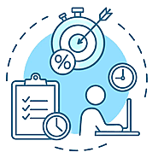

What we are working on
Milestones
Short Term Goals
Long Term Goals

Slide 9
Market Plan

Slide 10
Market Survey Findings
100 participants
80% interested
65% prefer to purchase online
35% prefer to purchase in-store

Slide 11
Market Analysis
Demand for efficient parking solutions is increasing
Targeting drivers valuing hassle-free parking experiences
Significant potential for growth due to increasing cars and need for smarter solutions

Slide 12



Competition & Strategies
Indirect Competitors
Google Maps
Waze
Direct Competitors
CelloPark
Parko
Pango
Marketing Strategies
Leverage social media and influencer marketing
Offer promotional deals and discounts
Focus on providing excellent customer service

Slide 13
Strength | Weaknesses:
Convenient, mobile app-based parking service Qualified and experienced team with expertise in parking industry, app development, and customer service Solid funding and investment to cover startup costs and ongoing development Streamlined and efficient operations and management systems | High startup costs, need for specialized technology Brand recognition challenges as a new entrant in the market Difficulty in finding and retaining qualified employees High production and marketing costs
Opportunities: | Threats:
Growing demand for mobile-based services, untapped markets Partnerships with established parking operators to expand reach Opportunities for growth and expansion through strategic partnerships and investments Potential to expand to new geographic locations and markets | Increasing competition, changes in technology or regulations Established competitors with well-known brands Economic downturns and changes in investor interest Changes in consumer behavior or preferences, and changes in technology or regulations
SWOT

Slide 14






PESTLE
Factor |  | Impact | Description
 | Political | Hight | Changes in government regulations could impact EasyPark's operations and revenue.
 | Economic | Hight | Changes in the economy could impact consumer spending on transportation services.
 | Social | Hight | Shifts in consumer preferences could impact demand for EasyPark's services.
 | Technological | Hight | Changes in mobile technology could impact EasyPark's ability to compete.
 | Legal | Medium | Legal challenges could impact EasyPark's operations and revenue.
 | Environmental | Low | Environmental regulations could impact EasyPark's operations and revenue.

Slide 15
Ansoff Matrix Analysis Introducing Our Product to New Markets
Analysis Based on Ansoff Matrix
Expand distribution channels to new markets
Launch marketing campaigns to increase brand awareness
Introduce new features to cater to the changing needs of customers
Product: Reliable and innovative parking and transportation services
Price: Competitive pricing strategy
Promotion: Digital and traditional advertising, collaborations with transportation partners, referral programs
Place: Online platforms, mobile applications, partnerships with parking facilities
Marketing Mix
Business model based on a low-cost strategy to offer affordable parking and transportation services to customers
Pricing strategy based on cost-plus pricing, including the cost of operations and a reasonable profit margin
Business Model & Pricing:

Slide 16

Financial Plan

Slide 17
Investment Opportunity in New Service Line
EasyPark has identified an opportunity to invest in a new service line that offers premium parking services
The investment required for this project is $1,000,000, which will be used for equipment, hiring staff, and marketing.
Financial Projections :
Launch: Jan 1, 2024
Revenue: Avg. $150,000/month in year 1
Gross Margin: 50%
Fixed Costs: $50,000/month
Variable Costs: 30% of revenue
Depreciation/Amortization: $10,000/month
Interest Expense: $5,000/month

Slide 19
Profit and Loss Forecast
Revenue: $150,000 per month
Cost of Goods Sold: $75,000 per month (50% of revenue)
Gross Profit: $75,000 per month
Operating Expenses: $40,000 per month
Depreciation and Amortization: $10,000 per month
Interest Expense: $5,000 per month
Net Profit before Taxes: $20,000 per month
Taxes: $4,000 per month (assumed at 20% of net profit before taxes)
Net Profit after Taxes: $16,000 per month

Slide 20
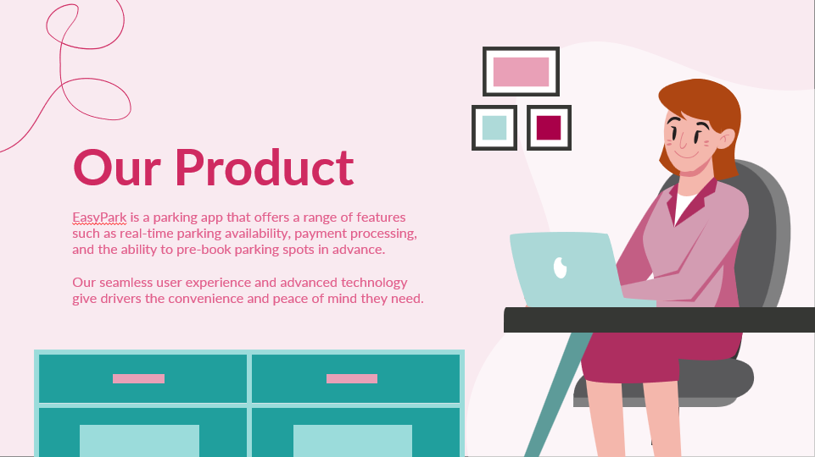
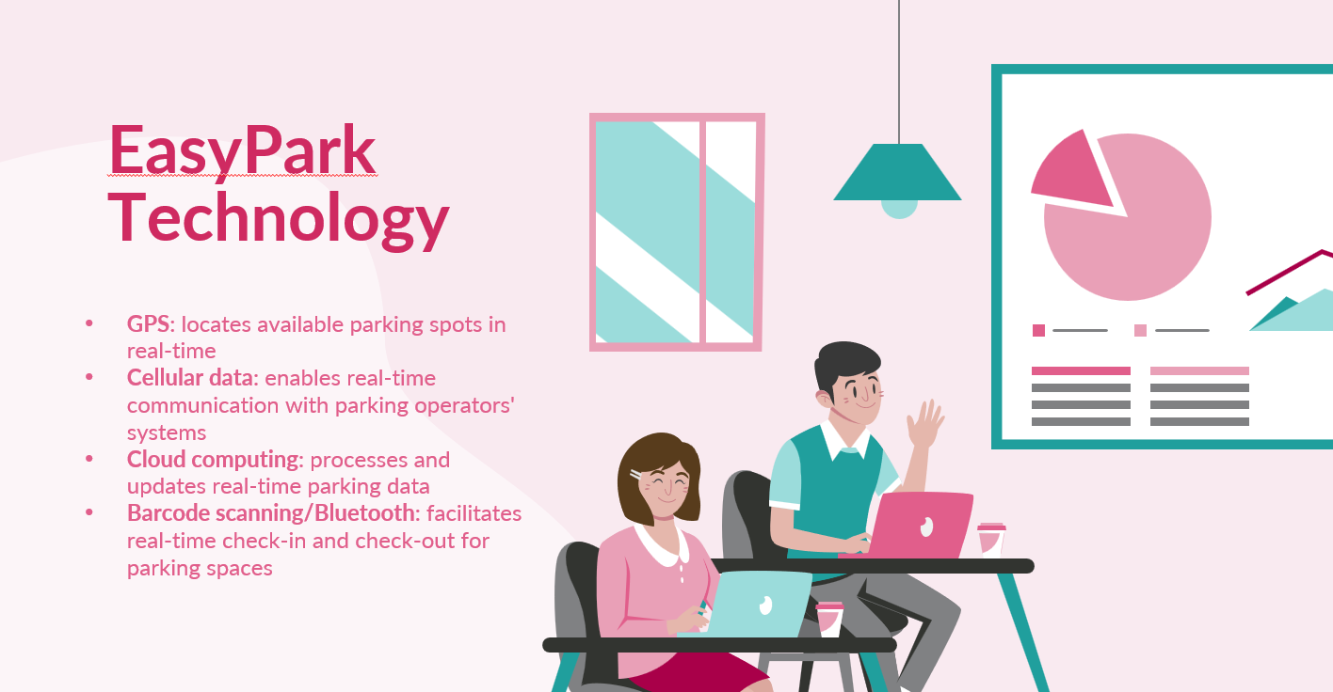
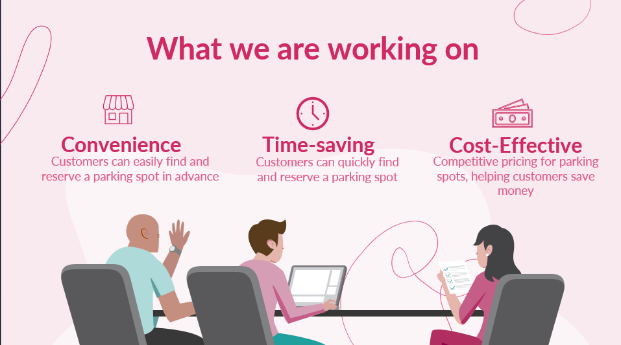

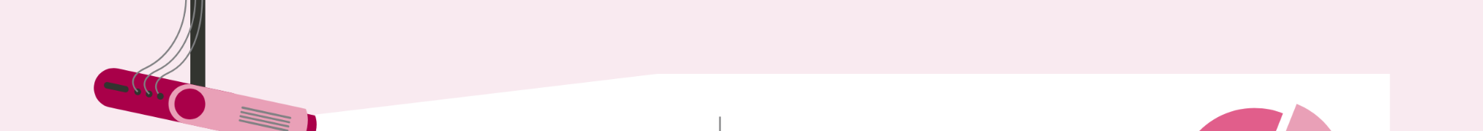

Budget
EasyPark will invest $1,000,000 in a new service line for premium parking services, using the budget for equipment, staff, and marketing
The budget breakdown is as follows:
Equipment: $500,000
Hiring staff: $300,000
Marketing: $200,000

Slide 21
Feasibility Analysis and Conclusions
The feasibility analysis indicates that investing in the new service line is a viable opportunity.
The analysis considered various factors, including market demand, competition, and financial projections.
The investment of $1,000,000 for the new service line will generate an average revenue of $150,000 per month in the first year, with a gross margin of 50%.
EasyPark can expect to break even in less than two years and generate significant profits thereafter.
Therefore, EasyPark should move forward with the investment in the new service line

Slide 22
Revolutionizing the Parking Industry
EasyPark's vision is to revolutionize the parking industry by delivering a seamless and innovative parking experience that exceeds our customers' expectations. We are committed to continuous improvement, customer satisfaction, and strategic partnerships to ensure our success as a leading player in the industry.
We are confident that EasyPark has a bright future ahead

Slide 23
The Lean Canvas
Designed for:
Designed by:
Date:
Version:
EasyPark
Hakam, Musa, Lina, Marah
26/02/2023
1.1
Problem
Solution
Unique Value Prop.
Unfair Advantage
Customer Segments
Urban drivers struggle to find available parking spots quickly and efficiently, leading to wasted time and frustration.
Traditional parking solutions are inconvenient, with limited space and high costs.
Parking enforcement is often inefficient, with manual monitoring and ticketing systems.
Real-time availability of parking spots through a mobile application.
Reservation and payment processing options for parking spots.
Integration with navigation systems for real-time directions to available parking spots.
EasyPark revolutionizes parking in Israel with a hassle-free mobile app that simplifies finding and paying for parking spots. With a commitment to exceptional customer service, innovative features, and competitive pricing, EasyPark sets itself apart from competitors. Targeting urban drivers, businesses, and municipalities, EasyPark leverages social media and influencer marketing, promotional deals, and excellent customer service to drive user acquisition and retention.
Our advanced parking enforcement technology and partnerships with parking lot owners provide us with a unique advantage that cannot be easily copied or bought.
Commuters who regularly drive to work in urban areas, tourists who need to find parking in unfamiliar cities, residents in urban areas who do not have access to convenient parking options.
Existing Alternatives
Key Metrics
High-Level Concept
Channels
Early Adopters
Competing apps : Pango, CelloPark, and Parko
Traditional parking garages
Street parking
Private parking spots
Number of downloads and active users
Revenue generated from parking spot reservations and payments
User satisfaction ratings and reviews
Number of parking lot partners and their revenue share
EasyPark is a mobile app-based parking solution that makes finding and paying for parking spots hassle-free for urban drivers in Israel. Our innovative features, exceptional customer service, and competitive pricing set us apart from the competition
App stores (iOS and Android), social media advertising (Facebook, Instagram, Twitter), influencer marketing partnerships with popular travel and lifestyle bloggers/vloggers, partnerships with parking lot owners and operators.
Our ideal customers are tech-savvy urban drivers who value convenience and time efficiency.
Cost Structure
Revenue Streams
Development and maintenance costs for the mobile application, marketing and advertising costs, partner commission fees, salaries and benefits for employees.
Commission on parking spot reservations and payments, advertising revenue from in-app ads and sponsored content, subscription fees for premium features (e.g. reserved parking spaces).

Slide 24

Resources and References
Zion Market Research: "Global Smart Parking Market Size, Share & Trends Analysis Report by Parking Site, by Technology, by Application and Forecast, 2020-2026" (https://www.zionmarketresearch.com/report/anpr-system-market)
"Israel Parking Management Market: by Parking Site (Off-street and On-street) and by Solution (Access Control, Security and Surveillance, Revenue Management, and Others): Opportunity Analysis and Industry Forecast, 2019–2026" (https://www.zionmarketresearch.com/report/smart-parking-systems-market)
MarketsandMarkets: "Smart Parking Market by Component (Hardware, Software, and Services), Type (Off-street and On-street), End-User (Commercial and Government), and Region - Global Forecast to 2025" (https://www.marketsandmarkets.com/Market-Reports/smart-parking-market-123959229.html)
"Smart Parking Market worth $7.5 billion by 2025" (https://www.marketsandmarkets.com/PressReleases/smart-parking.asp)
Israeli Ministry of Transport study finds parking is a major cause of congestion. (2021).
Ministry of Transport, Israel. Retrieved from https://www.gov.il/en/departments/news/27022021_01
Ravid, B. (2021). "More than half of Israeli drivers in urban areas struggle to find parking." Haaretz. Retrieved from https://www.haaretz.com/israel-news/business/.premium-more-than-half-of-israeli-drivers-in-urban-areas-struggle-to-find-parking-1.9773481
Noy, M. (2021). "Tel Aviv's hourly parking rates among world's highest." Globes. Retrieved from https://en.globes.co.il/en/article-tel-avivs-hourly-parking-rates-among-worlds-highest-1001366907
Avriel, E. (2020). "79% of Israelis believe parking prices in urban areas are too high." Calcalist. Retrieved from https://www.calcalistech.com/ctech/articles/0,7340,L-3781362,00.html

Slide 25

Thanks!
Do you have any questions?
EasyPark@gmail.com
+34 654 321 432
EasyPark.com
Please keep this slide for attribution

